Slide 1
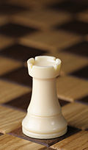
Chess end-game Analysis
Mark Enuma

Slide 2
The Dataset
https://archive.ics.uci.edu/ml/datasets/Chess+(King-Rook+vs.+King)
Data Set Characteristics: | Multivariate | Number of Instances: | 28056 | Area: | Game
Attribute Characteristics: | Categorical, Integer | Number of Attributes: | 6 | Date Donated | 1994-06-01
Associated Tasks: | Classification | Missing Values? | No | Number of Web Hits: | 65461
Attribute Information:
1. White King file (column)
2. White King rank (row)
3. White Rook file
4. White Rook rank
5. Black King file
6. Black King rank
7. optimal depth-of-win for White in 0 to 16 moves, otherwise drawn {draw, zero, one, two, ..., sixteen}.
Example:
a,1,b,3,c,2,draw
a,1,c,1,c,2,draw
a,1,c,1,d,1,draw
a,1,c,1,d,2,draw
a,1,c,2,c,1,draw
a,1,c,2,c,3,draw
a,1,c,2,d,1,draw
a,1,c,2,d,2,draw
a,1,c,2,d,3,draw
a,1,c,3,c,2,draw

Slide 3
The Dataset
Positions and number of moves are character/string. Transformed by me in Notepad++:
a,b,c,de,f,g,h replaced respectively with 1,2,3,4,5,6,7,8. So ‘a’,1 becomes 1,1.
Number of moves replaced with integer, so ‘one’ = 1.
‘draw’ is replaced with 17 because 0 already present in dataset.

Slide 4
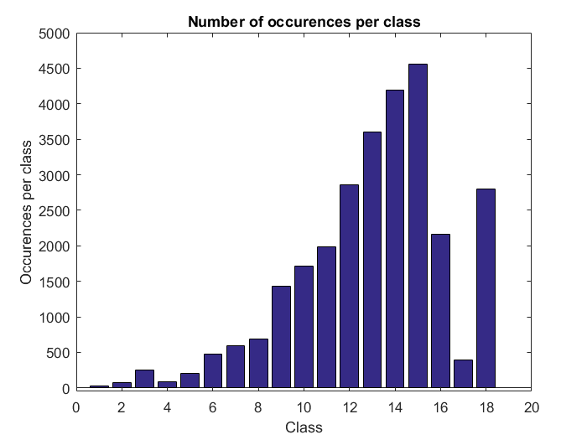
The Dataset

Slide 5
The algorithms and results
Because there are much classes i chose KNN and LQV as algorithms.
I used not normalized data and normalized data.
With KNN i used both Manhattan distance and Euclidean distance.

Slide 6
The algorithms and results
Accuracy KNN with Manhattan is 0.7069. Elapsed time: 00:10:18
Acc KNN,Manhattan,Norm is 0.5781. Elapsed time: 00:10:22
Accuracy KNN with Euclidean is 0.7067. Elapsed time: 00:07:36
Acc KNN,Euclidean,Norm is 0.4755. Elapsed time: 00:07:32

Slide 7
The algorithms and results
Accuracy LQV is: 0.0129.
Elapsed time: 00:10:0
Acc LQV,Norm,10 protos is: 0.0263.
Elapsed time: 00:10:09
Acc LQV,Norm,5 protos is: 0.0129.
Elapsed time: 00:05:04
Acc LQV,Norm,1 proto is: 0.0637.
Elapsed time: 00:01:07

Slide 8
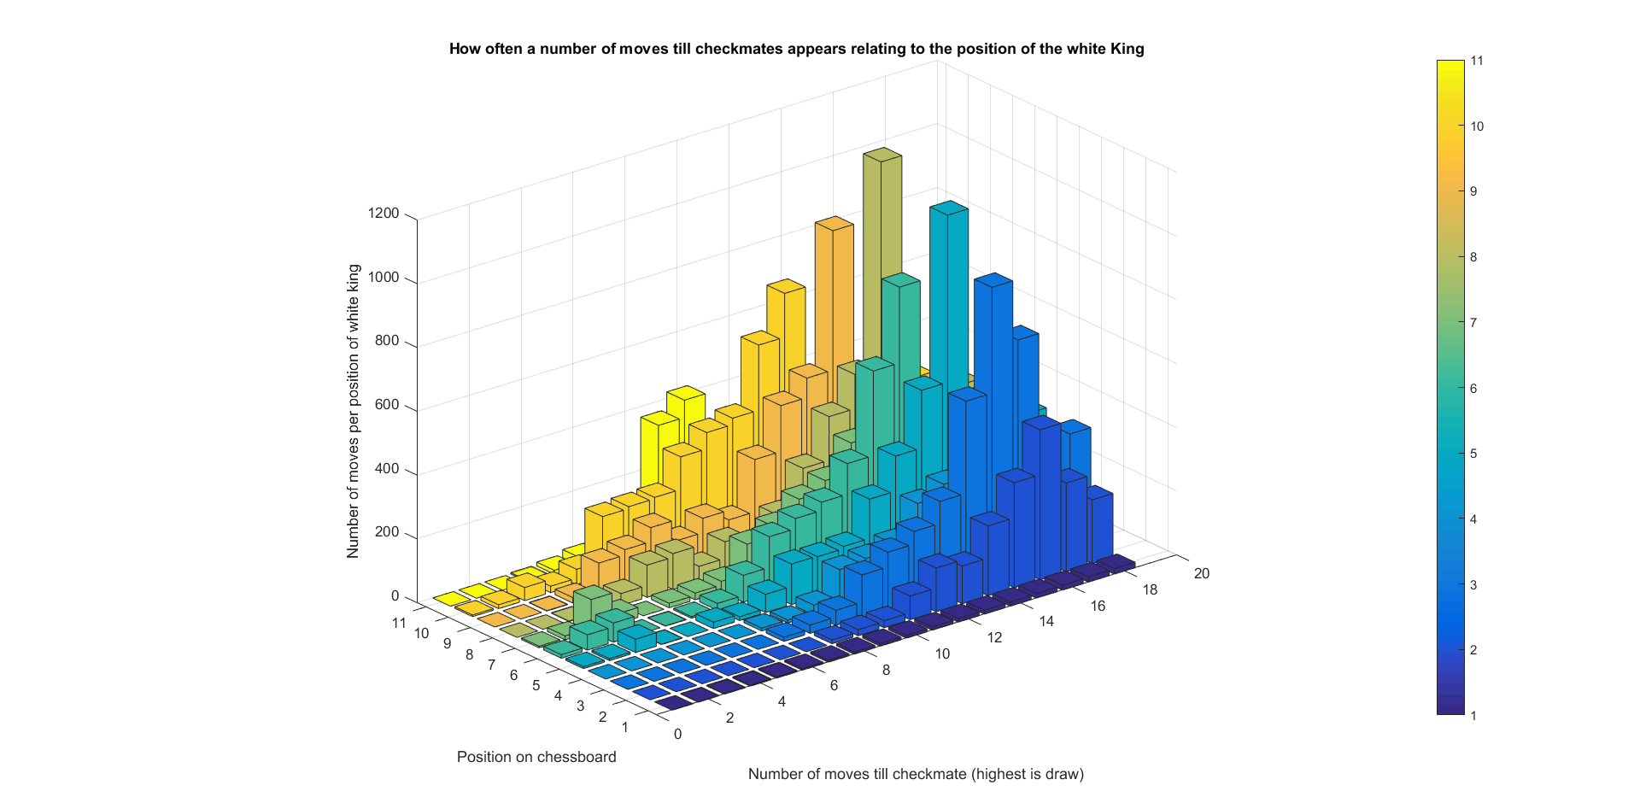
Some plots to try to explain the date

Slide 9
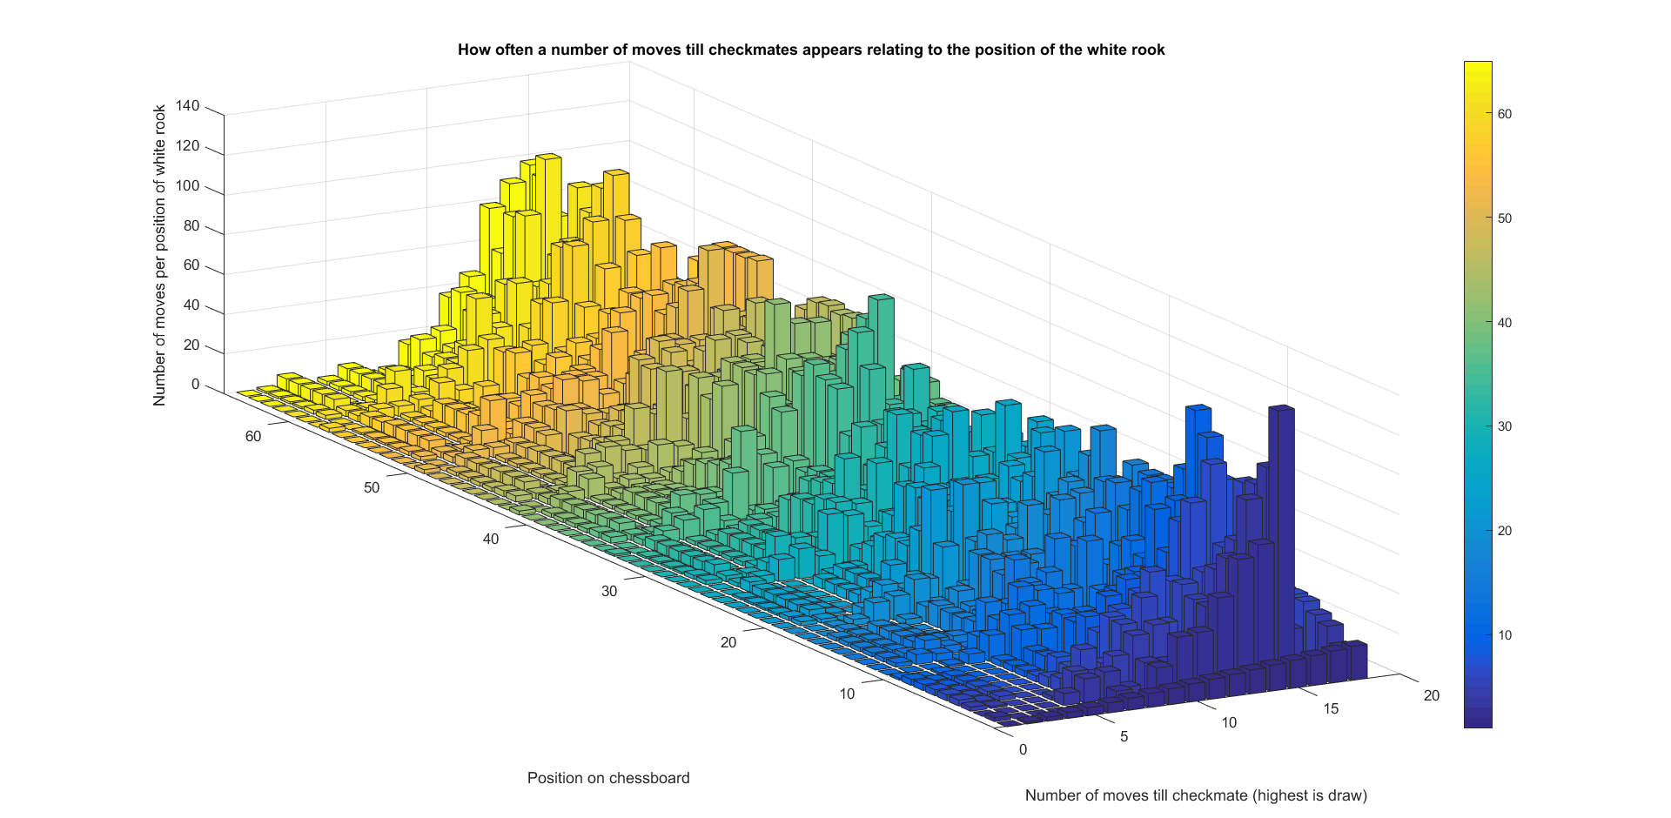
Some plots to try to explain the date

Slide 10
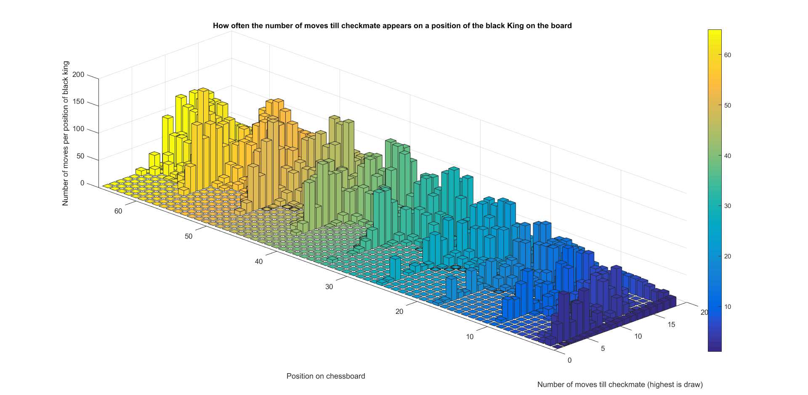
Some plots to try to explain the date

Slide 11
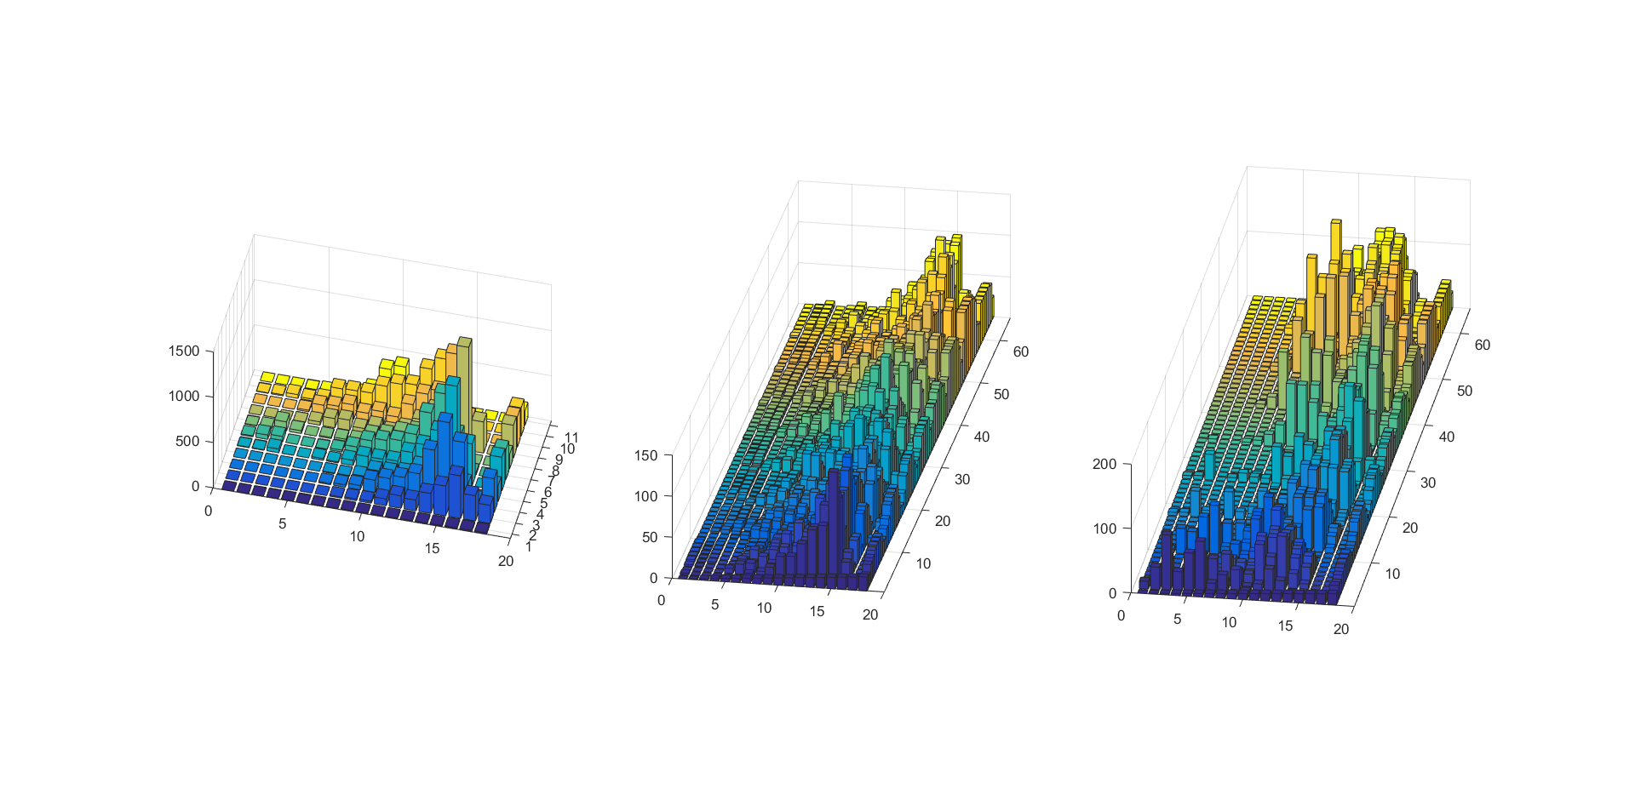
Some plots to try to explain the date

